Slide 1

CSE 11
Accelerated Intro to Programming Discussion Section 5
Sachin Deshpande, Summer 1 2021
This discussion is being recorded

Slide 2













Logistics
PA5 released yesterday, due Wednesday
Exam THIS week!
PA6 easier, PA7 hard.

Slide 3











Arrays
An ordered sequence of values
(int, double, String, YourClass, array, …)
Syntax of creating an array:
int[]
int[]
int[]
int[]
nums1 nums2 nums3 nums4
= { 4, 2, 7 };
= {};
= new int[5];
= nums1;
// Be careful!!! “CSE11”};
String[] strs1 = {“Hello”,
Array length:
int nums1Length = nums1.length;

Slide 4
























Arrays cont’d
Use index to access elements in an array:
int[] nums1 = { 4, 2, 7 };
int firstElem int secondElem int thirdElem int fourthElem
= nums1[0];
= nums1[1];
= nums1[2];
= nums1[3];
// 4
// 2
// 7
// Index
3 out of bounds for length 3
Modify elements in an array:
nums1[2] += 1; // nums1 becomes { 4, 2, 8 }
Array length is fixed:
Can modify elements, but cannot add/delete elements
nums1 = { 4, 2, 7, 8 } // need to assign a different
array

Slide 5













Main
public static void main(String[] args){...}
You saw this in PA0.5
Entry point to a Java program
javac DiscussionExamples.java
java DiscussionExamples
There needs to be a main method in the class DiscussionExamples
args – an array of Strings (command line arguments)
java DiscussionExamples some some arguments

Slide 6

















Loop Basics
How to access elements in a very very long array?
Loops
For-loop
for (int i = 0; i < arr.length; System.out.println(arr[i]);
}
For-each loop
for (int element : arr){ System.out.println(element);
}
While loop
int i = 0;
while (i < arr.length){ System.out.println(arr[i]); i++;
}
i++){

Slide 7
Quick Midterm Review…

Slide 8
















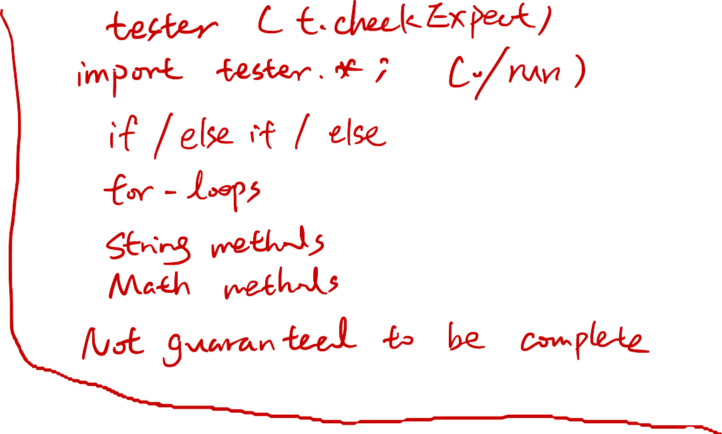





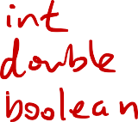



















Exam

Slide 9
Fields vs Member Variables
Fields = member variables = instance variable
Variables in functions are different! Local variables

Slide 10
Tester
import tester.*;
class Test1 {
int method1() { . . . } // week1 - test as a single method to a field
int field1 = this.method1();
//wed of Week2
boolean testMethod1(Tester t) {
return t.checkExpects(this.method1(), 1);
} }
How it works:
Method 1: observe output, see if it is what you expect
Method 2: use a built-in method in Tester class to compare actual to expected value.

Slide 11
Testing
The point of testing is to break your program
Suppose I have a method foo(n) that adds 2 to your number
Would it be better to test foo(2), foo(3), foo(4),…?
No! Try foo(0), foo(-100000), foo(10000000), foo(“string”), etc.

Slide 12
PA5

Slide 13











Thanks!

